Slide 1


Slide 2
Nice to meet you!
Thank you for coming !
Hi! Let’s begin now!

Slide 3


Storyboard
Q & A
About Us
Best Practices
Out of the Box
Squad Nova Highlights

Slide 4
About Us
Section 1
We are awesome!
DTCC Confidential (Yellow)

Slide 5
Our Journey
Turning point!
2016 –
Phase I
2016 –
Phase II
2017 –
Phase I
2017 –
Phase II
2018
Birth
Crawling
Walking
Running
Marathon
Birth of Squad Nova.
Knowledge sharing sessions and work on first story.
Started working on defects and small enhancements.
Worked on major client
deliverables.
Maintenance
Releases
Natesa
Vasundra
Vijay
Aneesha
Raj
Yaser
Sudhitra
Bhagya
Divya
Jeeva
Vijayaraman
Charles

Slide 6
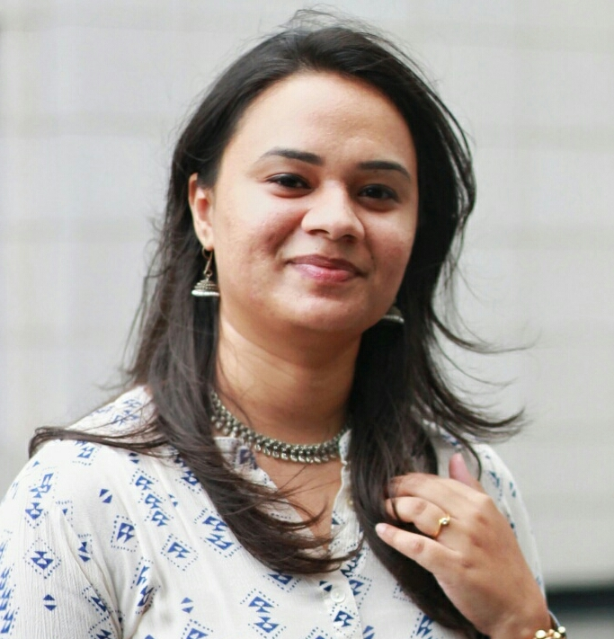
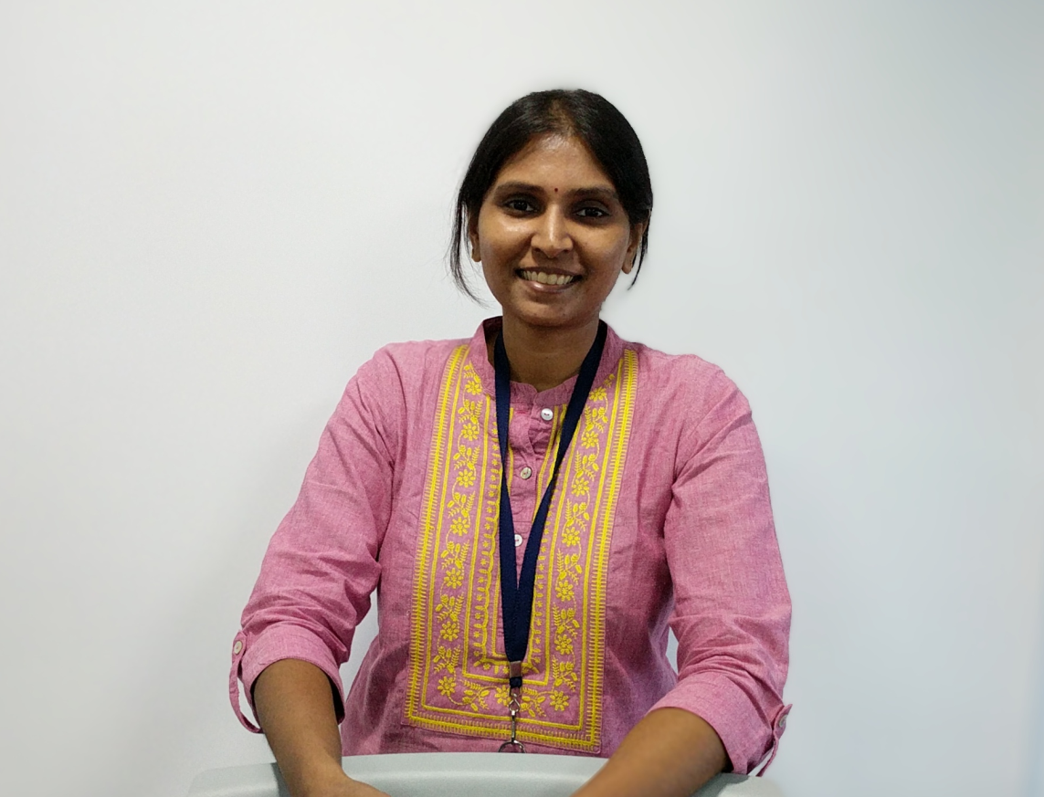
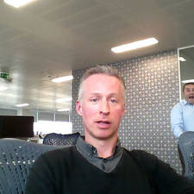
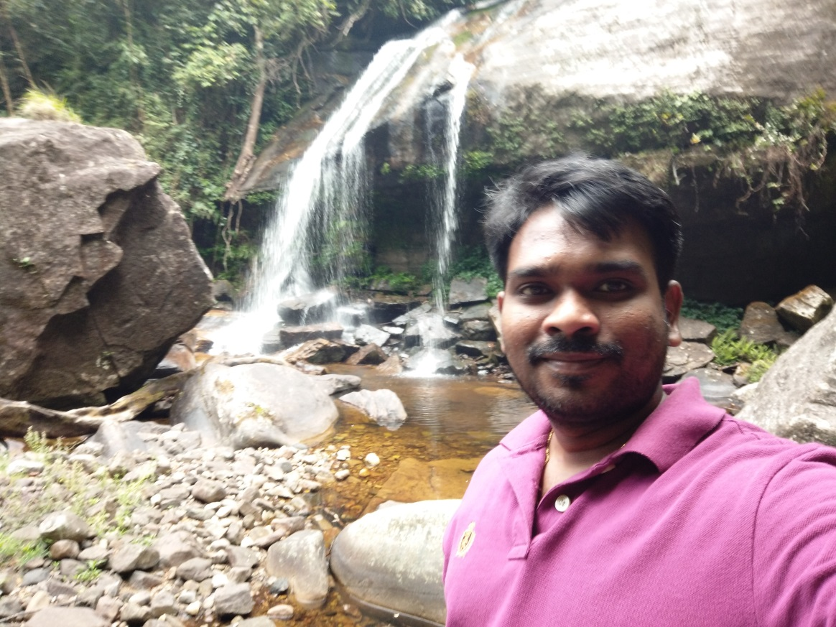
Meet the awesome crews!
Product
Detective
PMO
TPM
Prober
Aneesha
Sudhitra
Narrator, perfection to detail.
Agile and Self Evolving.
Jon
Methodical, team player.
Appreciator and defender.
Vijayaraman
Proof reader.
Tourist and adventure seeker.

Slide 7
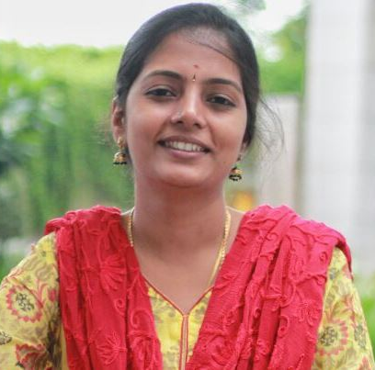
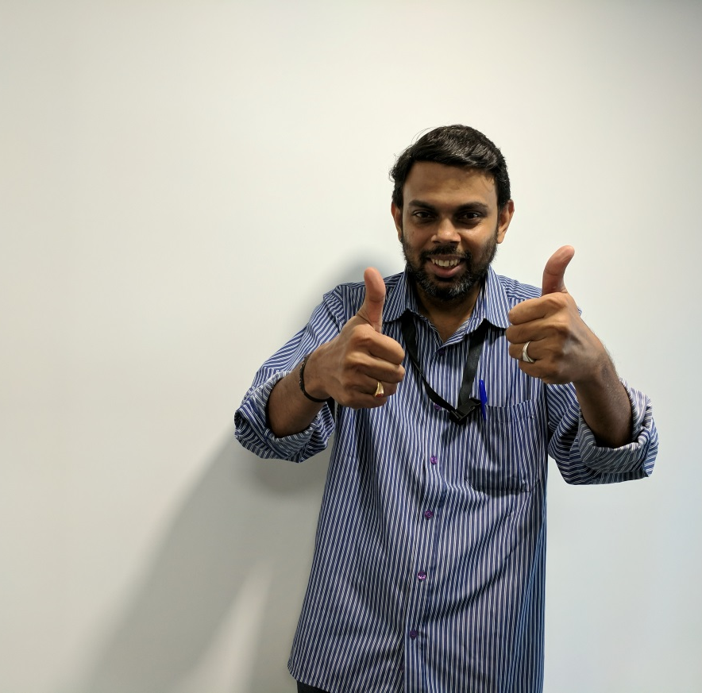
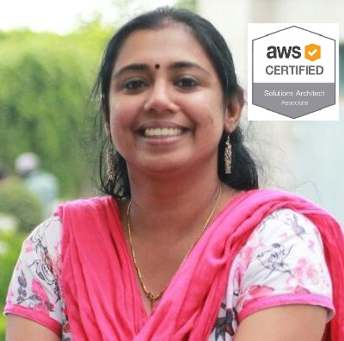
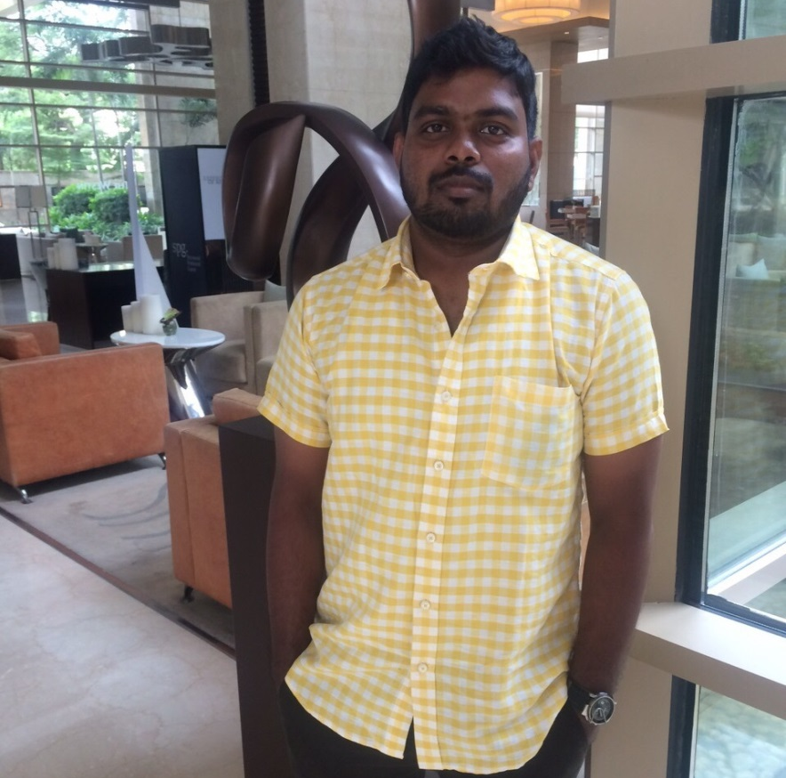
Meet the awesome crews!
Gladiator
Data Guy
The Boss
Bug Digger
Vasundra
Vijay
Master of all trades.
Whistle blower.
Voracious reader, adventurous and thrill seeker.
AD ONE-Mobility Pillar Ambassador.
Bhagya
Collaborative.
Easy going.
Charles
Code breaker.
Music lover ,creator and biryani lover.

Slide 8
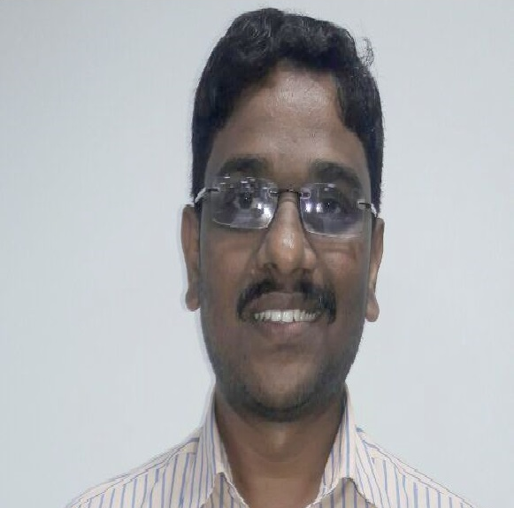
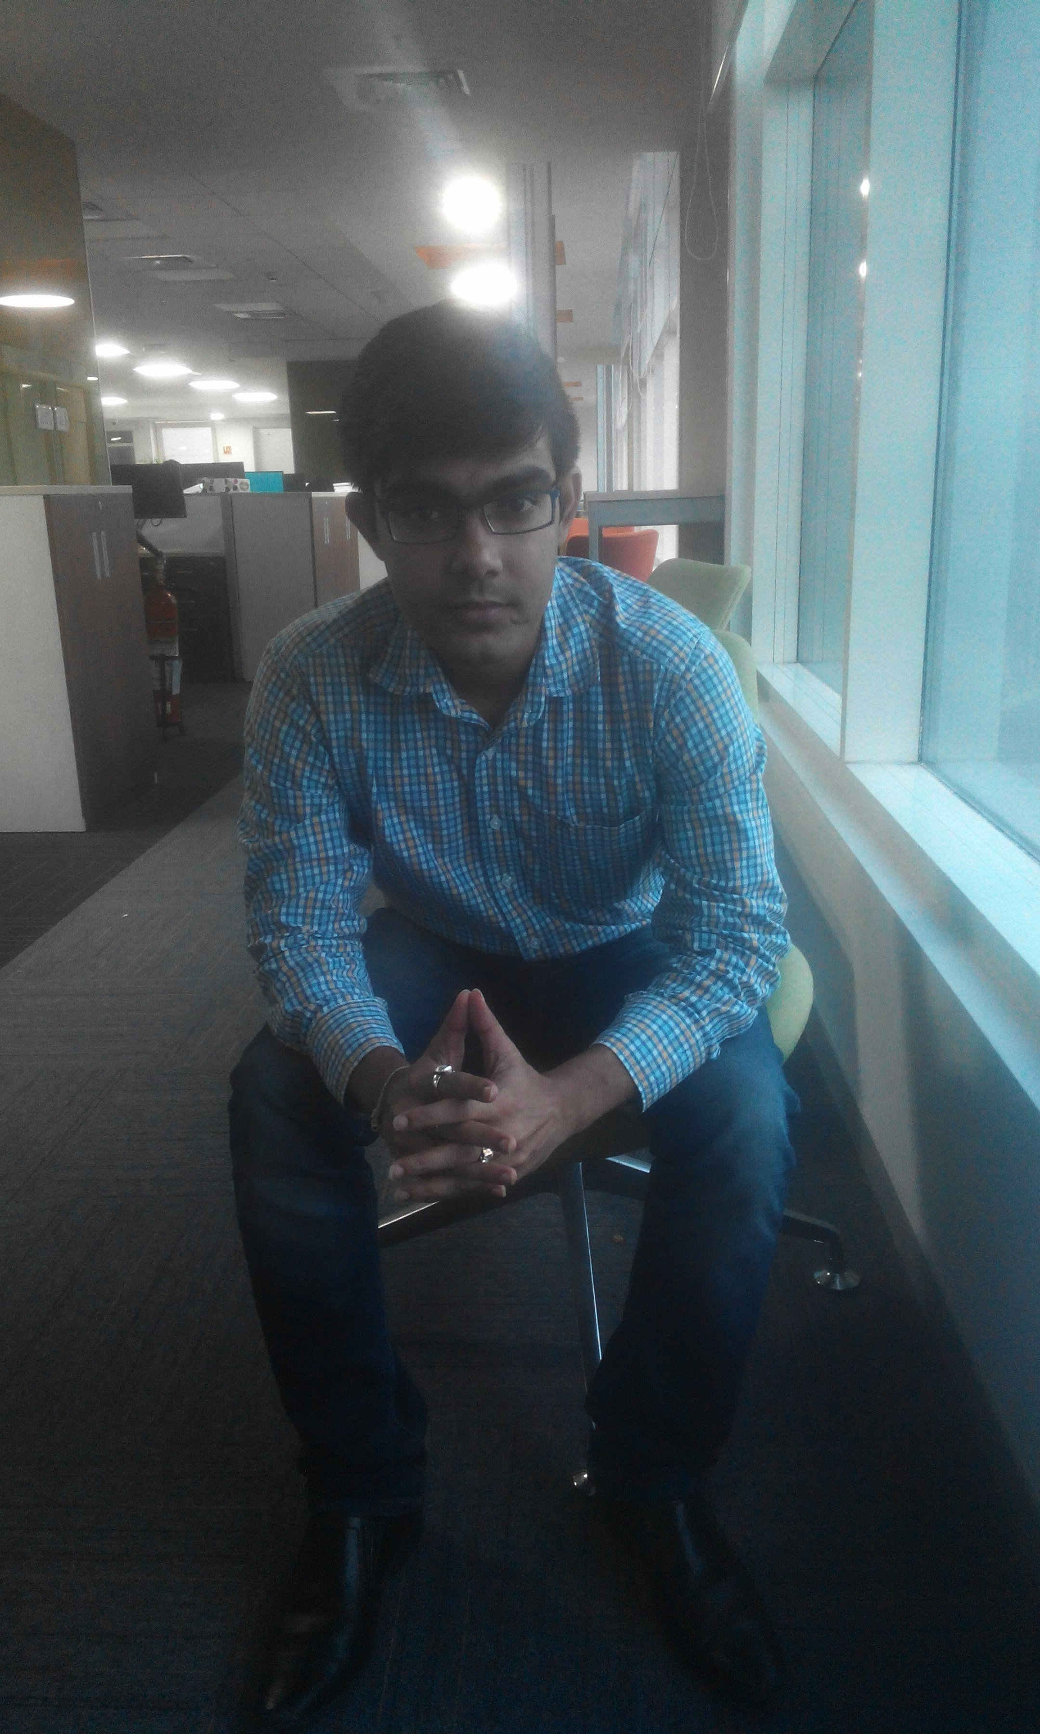
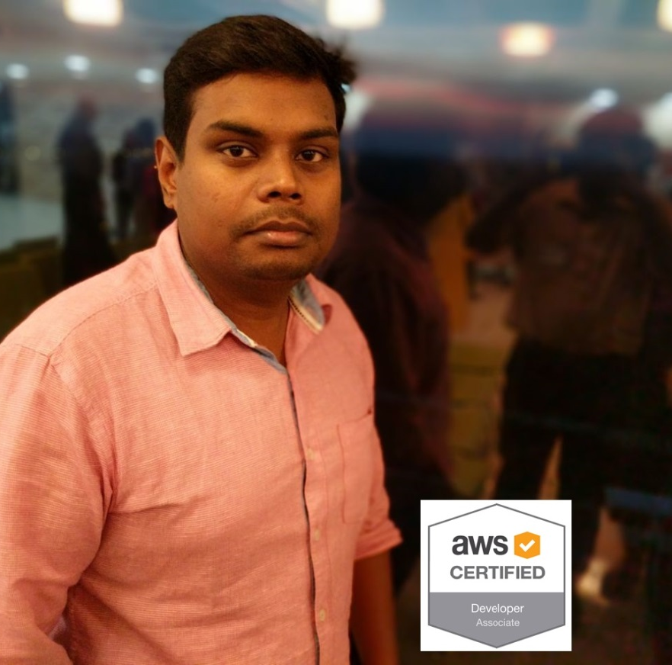
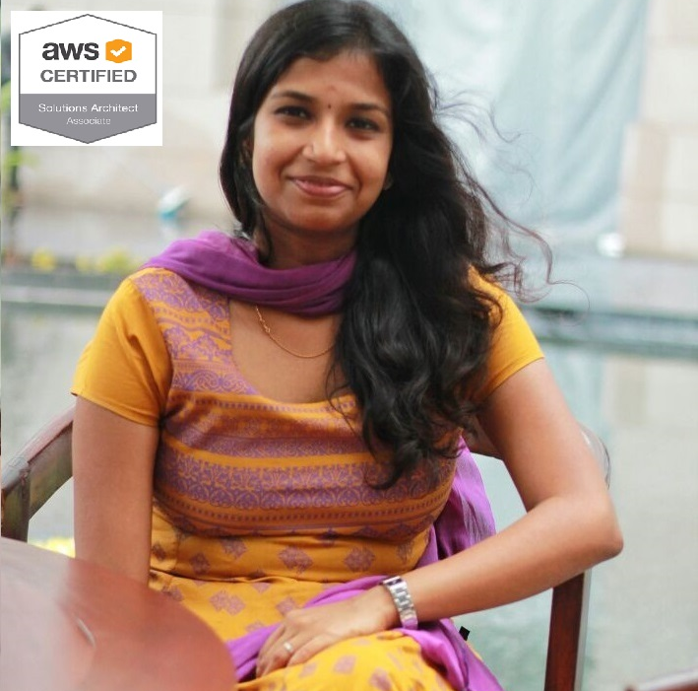
Meet the awesome crews!
Thinker
Rockstar
Philosopher
Whizkid
Jeeva
Raj
Silent and sensible.
Attentive.
Late night owl.
Java brewer.
Yaser
Traveler, foodie.
Tech aficionado.
AD ONE-Education Pillar Ambassador.
Divya
Still yawning.
Out-and-out.
AD ONE-Networking Pillar Ambassador.

Slide 9
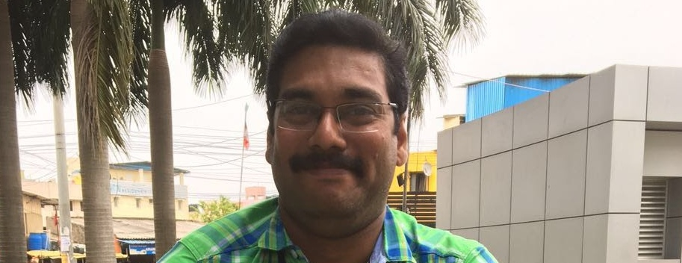
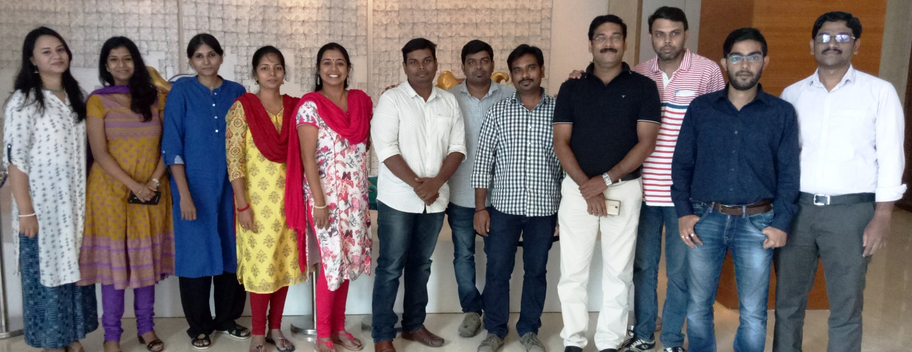
Meet the awesome crews!
Mr. Mystic
Squad Nova - Crew Party
Uncomplicated.
Big Kahuna.
Aye Aye .

Slide 10
Squad Nova Highlights
Section 2
Our Story !
DTCC Confidential (Yellow)

Slide 11
The stories so far….
LEI in SWIFT - 2016
In support of the SWIFT 2016 maintenance release, investment managers are able to use a new format option L so that a Legal Entity Identifier (LEI) can identify a place or party. If investment managers want to use the additional identifier in their SWIFT messages, they need to subscribe to TLEI.
Broker Allegement Visibility
When the IM uses a BRMG, the Broker cannot see trades alleged it until the trades are paired.

Slide 12
The stories so far….
MIFID-II Regulatory Reporting
There are a total of 65 fields which MiFID imposed as a part of MiFID II reporting requirements, out of which 17 fields already exist in CTM. M2RF subscription option is created to accommodate the new MiFID II fields in CTM.
New Commission Types in CTM – XML Direct and Legacy Fix
To meet MiFID II Research unbundling payment requirements and in support of the process that applies research amounts on all, some, or none of investment manager's allocations and broker/dealer's confirmations, a new Commission Type- RSCH (Research) is introduced in CTM.

Slide 13
Best Practices
Section 3
Please Take Note !
DTCC Confidential (Yellow)

Slide 14
4 pillars
Low level code changes , whitebox test cases and Junit test cases.
Creation of understanding document on QA environment and tools.
Technical Documentation
QA Knowledge Base Document
Acceptance Tests by BA
Agile
Creating acceptance tests by BA for enhancements and defects. Validating acceptance test cases of QA.
Transparency, Time boxed iterations, Definition of Done.

Slide 15
Out of the Box
Section 4
Think !
DTCC Confidential (Yellow)

Slide 16
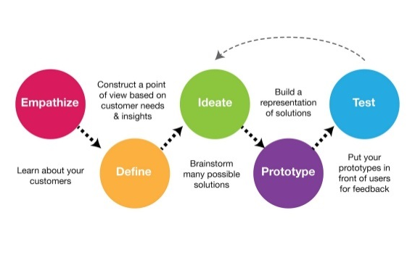
Purpose and goal
Design Thinking Session
Design Thinking is a methodology used by designers to solve complex problems, and find desirable solutions. A design mindset is not problem-focused, it's solution focused and action oriented towards creating a preferred future.
2 day session organized in Boston, Chennai and London.
Development team created a Development Journey Map to visualize the process that a developer goes through in order to develop a change request. It’s used for understanding and addressing developer’s needs and pain points.

Slide 17
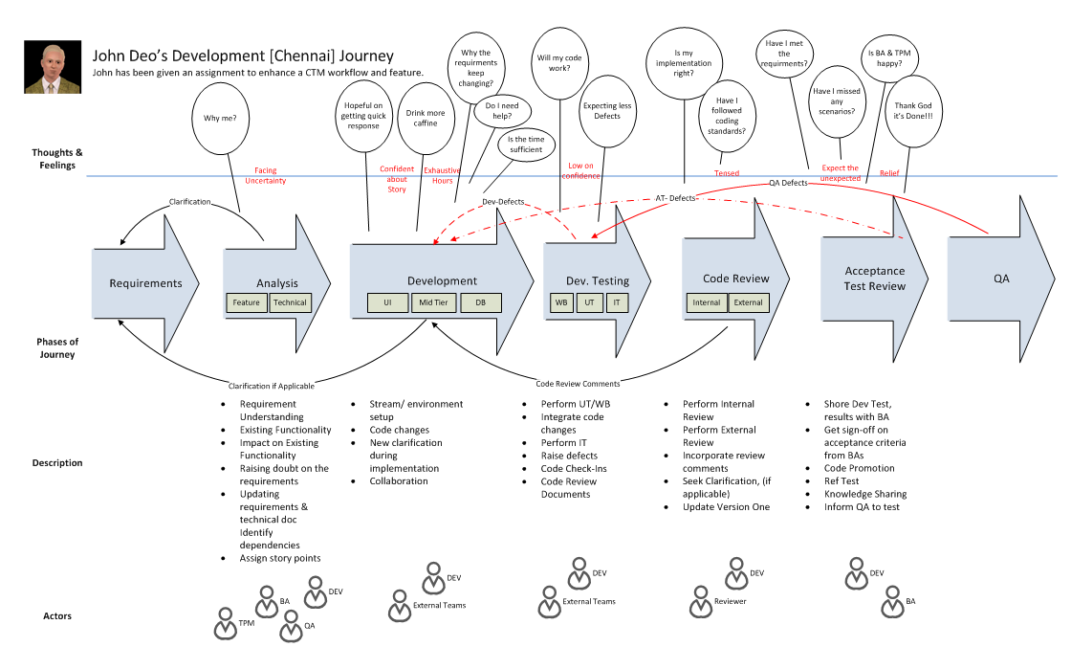
Process to success
No magic potion

Slide 18
Q and A
Section 5
What team wants ?
DTCC Confidential (Yellow)

Slide 19
Life is either a daring adventure or nothing.
by Helen Keller
DTCC Confidential (Yellow)

Slide 20
Thank you! ☺
That’s all!
DTCC Confidential (Yellow)

